Slide 1

Vanilla Corp. – Preparing to Release Solution into Production Recommendations & Next Steps
RETAIL SOLUTIONS
Celia Muriel – 9th October 2019
Solutions Architect

Slide 2
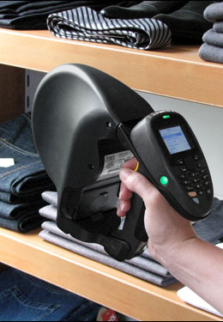
Goal Of This Presentation
Vanilla Corp. will soon release an major modification in the architecture of their IT ecosystem to better support their core business
Role of Vanilla Corp.’s IT solution within Vanilla Corp.’s ecosystem
Status of Vanilla Corp.’s Project
Deadlines
Discuss on how to release our solution into production and maintain it in order to most leverage and benefit out of IT investments and support accomplishment of business objectives

Slide 3

Agenda
Ecosystem Overview
Vanilla Corp. Ecosystem Monitoring
Status Of Our IT Solution
Expected Used Of Our IT Solution
Performance Testing
Governance & Security
Objectives, Recommendations & Next Steps

Slide 4
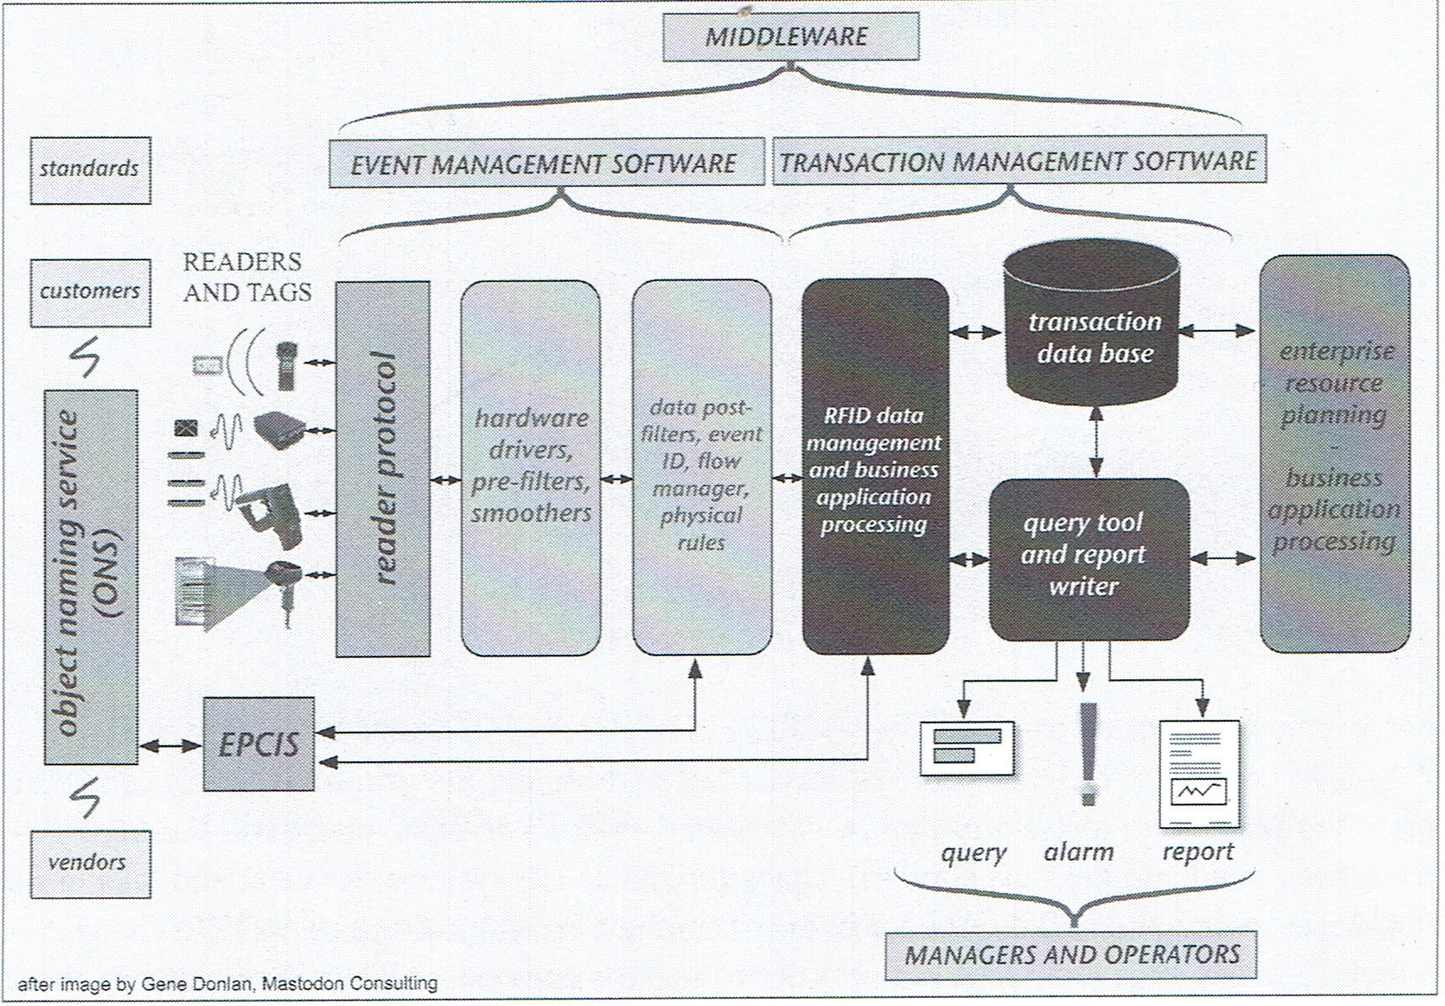
Vanilla Corp. Ecosystem Architecture
Overview of Vanilla Corp.’s Ecosystem Architecture.
20191009_RFID sensor within IT infrastructure.
It is a large architecture, with many systems involved, and interconnected. In order for the architecture to work swiftly, every system must provide with response in a timely manner.
Mission Critical Environment*
* Essential to the survival of Vanilla Corp.’s core business
Image via “The RF in RFID. UHF RFID in Practice” by Daniel M. Dobkin. Newnes, Elsevier. Second Edition

Slide 5
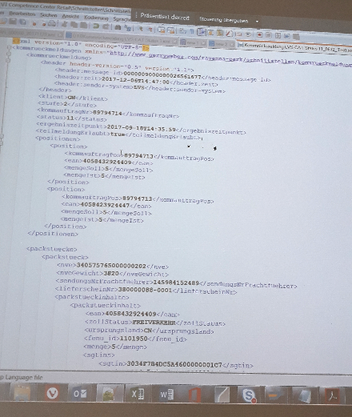
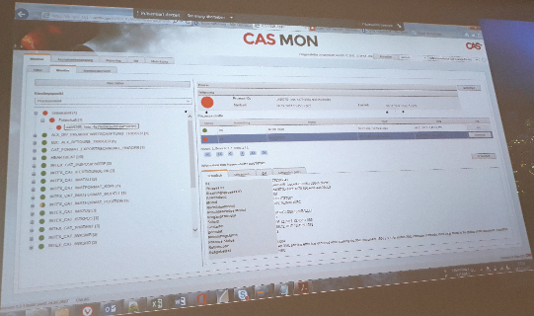
Vanilla Corp. Ecosystem Monitoring
Vanilla Corp. has deployed a monitoring tool to ensure availability and overall performance of processes running in the ecosystem
It does not diagnose specific uses which cause delays or errors → the stakeholder of each component must provide with a timely reply and solution for any incident

Slide 6
Proposed Tests Prior to Releasing into Production

Pricing the issue
Functional testing.
Components have been tested in a lab environment with low data and tag volumes, but it is necessary to test real data and high-volumes
Performance testing to ensure that the components perform adequately.
Load testing to ensure that the components perform under anticipated load.
Endurance testing to ensure that the components perform under load over an extended period of time.
Disaster recovery to ensure that the system can be recovered in the event of some kind of disaster.
The above applies to both server and client side components


Prospectus

Slide 7

Goal Of Preparation Efforts To Release Into Production I
Most leverage and benefit out of our solution and support accomplishment of business objectives
Maintain data quality
Estimate how long initial loads and daily loads are going to take
Use for planning purposes during rollout
Estimate initial infrastructure capacity requirements
Respond to the question what to do when the amount of data or concurrency in the solution increases
Scalability
Workaround to lose network connection in stores
Provide with a timely reply and solution when issues arise

Slide 8
Goal Of Preparation Efforts To Release Into Production II
Set expectations about performance and capacity as test results will be obtained in a particular infrastructure, which may be different on the Production system
Factors which influence results
Middleware version and configuration
Physical systems/ virtual machines
If virtual machines: hypervisor, its configuration, and the hardware underneath it
Concurrency on the solution: Reporting, Back Office, Cycle Counts, data loaded from Enterprise Systems and Business Applications
Amount of data
Operating System and Database version
Network

Slide 9

Suggested Performance Tests I
Make load tests to estimate ingestion rates and times to anticipate reply to customer on deployment and set expectations
REST API and Web Services
Make several tests where the amount of data is larger in every test
Concurrency tests to anticipate to customer’s concerns and set expectations
RFID/ Mobile devices and Middleware
More than one call in the REST API
Web Services
All the above at the same time
Disaster Recovery scenario
Full capacity tests (space, CPU, I/O) to understand the solution’s behaviour during peak timeframes, high season or unexpected events
Run heavy workloads in all components simultaneously
Lose network connection at stores

Slide 10

Suggested Performance Tests II
Duplicate and null IDs
Reference number
deliveryNumber
Nummer der Verpackungseinheit (NVE) or Serial Shipping Container Code (SSCC)
trackingNumber
Electronic Product Code (EPC)
European Article Number (EAN)
Advanced Ship Notice (ASN)
Foreign keys which don’t exist in the master table
Wrong data formats and wrong data types
IDs
Length, particular formats as the barcodes, etc.
Dates, timestamps and times
No UTC, no ‘YYYY-MM-DD’
Expect a number and receive characters, dates, etc.

Slide 11

Governance I
Disaster Recovery
Backups, restores
Provide with timely reply and solution for incidents observed in the Vanilla Corp. monitoring tool
Software upgrades and migrations
Middleware
APIs
Back Office
Mobile
Operating System and Databases
What to do when the amount of data/ concurrency increases

Slide 12
Governance II
Procedure to report incidents
Customer → Vanilla Corp.
Internally within Vanilla Corp.
Incident categorization
Regular maintenance tasks
Tools in place for troubleshooting
Data Quality rules
Duplicated keys
Null keys
Foreign keys which don’t exist in the master table
Wrong data formats and wrong data types

Slide 13

Security
Create new users and roles
Decommission old users and roles
Passwords
Define procedures to change them
Format, length
Password vault
Authorization to have it
Define procedures and how to grant access to the solution for maintenance tasks or troubleshooting

Slide 14
Immediate Objectives

Pricing the issue

Agree the scope of tests to be performed (Performance, Load, Endurance etc.)
Agree when in the project lifecycle the various testing activities should be performed.
Determine who is accountable and responsible for the delivery of the testing activities.
Understand the likely work effort required for such testing activities (order of magnitude 10/100/1000 days).
Agree on follow up activities and meeting cadence.

Prospectus
Slide courtesy of Iain Ritchie

Slide 15

Recommendations and Next Steps
Discuss and agree on immediate objectives
Include task prioritization
Involve Software Engineering/QA teams in the discussion
Measure performance
Make an Operations Manual
Details on how to operate Governance and Security
Discuss with the customer
Data volumes are expected to be loaded initially and daily to estimate solution requirements as well as the best way to perform certain activities (e.g., initial load, full cycle count)
SLAs. E.g., if a system crashes and needs to be restored, how much time it should take? Would 2 days be OK? Is this time SLA feasible with current capabilities, features, support contract and hardware?
Identify test environment details where testing is going to be carried on

Slide 16

Recommendations and Next Steps
Define test metrics which are captured and shared
Number of test cases
Number of defects
Number of tests executed against the ones planned
Execution time as per test conditions
Set expectations

Slide 17
Comments, please

